Slide 1
MODULE 2: BASELINE ASSESSMENT
Session 18: Understanding Agricultural Production Systems
Notes:
Understanding Agricultural Production Systems

Slide 2

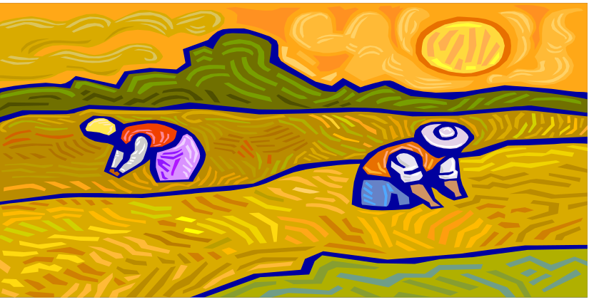
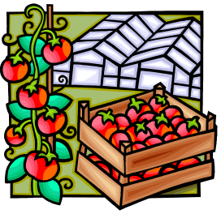

Key components of Agricultural Economy
Food crop production
Amount and type of land available
Cash crop production
Livestock production
Session 18: Understanding Agricultural Production Systems
Notes:
All three basic kinds of rural product - food, cash crops, livestock - are affected by the amount of available, arable land. In the case of crops there is an obvious connection, but the question then arises of the possibilities of intensifying production on the same amount of land. For rural households in developing countries, this challenge is increasingly difficult to meet. The cost of chemical fertilizers, especially in the last decade or so of Structural Adjustment and the disappearance of subsidies, is increasingly prohibitive for poor farmers to use on staple crops, and even limits what they can put on cash crops with good price prospects
In many agricultural settings livestock and their products bring as much cash to farmers as what they are able to sell from their fields. In highland Ethiopia people commonly refer to their smallstock is 'our money'. At the same time, milk is an important addition to the diet, and a highly palatable one, when rural households are in a position to consume significant quantities. But arable land is usually critical for a farmer's livestock production too. Those same Ethiopians have an old saying: "A man who has many animals has much land."
Understanding Agricultural Production Systems

Slide 3
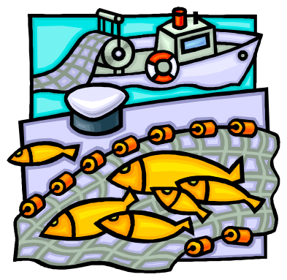


Key components of Agricultural Economy
Fishing
Amount and type of land available
Wild food collection
Session 18: Understanding Agricultural Production Systems
Notes:
It also determines the degree to which people turn to alternative options such as fishing and wild food collection – in areas where land is less successful at securing crops, fishing or wild foods are often an option, depending on water and vegetation sources.
Understanding Agricultural Production Systems

Slide 4
Key components of Agricultural Economy
Land pressure often results in the accumulation of land in the hands of wealthier members because poorer households tend to lack the labour and capital to farm big tracts of land
Session 18: Understanding Agricultural Production Systems
Notes:
HEA records the way in which communities adapt to land shortage, insofar as they can without simply migrating to the city. This adaptation cannot be understood without looking at the wealth division within the community. Except in the very rare circumstance of rigid official control of land users as well as land ownership, population pressure has the effect of accumulating land use in the hands of wealthier members of the community. This comes about by various means. A poor farmer under a particular need or misfortune may take loans from a richer neighbour which he cannot repay, so that first his labour and then his land, or the use of it, become increasingly forfeited to the creditor. Or a farmer may rent out a proportion of his land to a richer neighbour because he cannot cover the labour or other inputs required to use all his land profitably; or because he needs to pay somehow for the rent of draught power, whether oxen or tractor, which he doesn't own himself; or simply because it is more profitable for him to work elsewhere than to devote his labour to his land. Some or all of these factors tend to be even stronger in the case of female-headed households.
Thus whilst wealthier farmers produce the surpluses of staple crops, poorer farmers tend to get half or more of their livelihood from activity off their own land, because they have no other option or because of opportunity cost judgements. But the corollary is that they must be able to buy the food and other essentials that they do not produce, and so the cash economy - the availability of paid work, the going wage for it, and the price of goods - becomes paramount. These fundamental factors are analysed in a quantified way between the three pillars of HEA inquiry: sources of household food; sources of household cash; pattern of household expenditure.
Understanding Agricultural Production Systems

Slide 5
Key components of Agricultural Economy
To be better off means to own productive assets, like livestock and land, and to make some profit off your production
To be poorer means to work for others
Session 18: Understanding Agricultural Production Systems
Notes:
HEA records the way in which communities adapt to land shortage, insofar as they can without simply migrating to the city. This adaptation cannot be understood without looking at the wealth division within the community. Except in the very rare circumstance of rigid official control of land users as well as land ownership, population pressure has the effect of accumulating land use in the hands of wealthier members of the community. This comes about by various means. A poor farmer under a particular need or misfortune may take loans from a richer neighbour which he cannot repay, so that first his labour and then his land, or the use of it, become increasingly forfeited to the creditor. Or a farmer may rent out a proportion of his land to a richer neighbour because he cannot cover the labour or other inputs required to use all his land profitably; or because he needs to pay somehow for the rent of draught power, whether oxen or tractor, which he doesn't own himself; or simply because it is more profitable for him to work elsewhere than to devote his labour to his land. Some or all of these factors tend to be even stronger in the case of female-headed households.
Thus whilst wealthier farmers produce the surpluses of staple crops, poorer farmers tend to get half or more of their livelihood from activity off their own land, because they have no other option or because of opportunity cost judgements. But the corollary is that they must be able to buy the food and other essentials that they do not produce, and so the cash economy - the availability of paid work, the going wage for it, and the price of goods - becomes paramount. These fundamental factors are analysed in a quantified way between the three pillars of HEA inquiry: sources of household food; sources of household cash; pattern of household expenditure.
Understanding Agricultural Production Systems

Slide 6
Key components of Agricultural Economy
This means that poorer households need to buy the food and other essentials that they do not produce
The cash economy is therefore critical to a study of rural economy
Session 18: Understanding Agricultural Production Systems
Notes:
HEA records the way in which communities adapt to land shortage, insofar as they can without simply migrating to the city. This adaptation cannot be understood without looking at the wealth division within the community. Except in the very rare circumstance of rigid official control of land users as well as land ownership, population pressure has the effect of accumulating land use in the hands of wealthier members of the community. This comes about by various means. A poor farmer under a particular need or misfortune may take loans from a richer neighbour which he cannot repay, so that first his labour and then his land, or the use of it, become increasingly forfeited to the creditor. Or a farmer may rent out a proportion of his land to a richer neighbour because he cannot cover the labour or other inputs required to use all his land profitably; or because he needs to pay somehow for the rent of draught power, whether oxen or tractor, which he doesn't own himself; or simply because it is more profitable for him to work elsewhere than to devote his labour to his land. Some or all of these factors tend to be even stronger in the case of female-headed households.
Thus whilst wealthier farmers produce the surpluses of staple crops, poorer farmers tend to get half or more of their livelihood from activity off their own land, because they have no other option or because of opportunity cost judgements. But the corollary is that they must be able to buy the food and other essentials that they do not produce, and so the cash economy - the availability of paid work, the going wage for it, and the price of goods - becomes paramount. These fundamental factors are analysed in a quantified way between the three pillars of HEA inquiry: sources of household food; sources of household cash; pattern of household expenditure.
Understanding Agricultural Production Systems

Slide 7
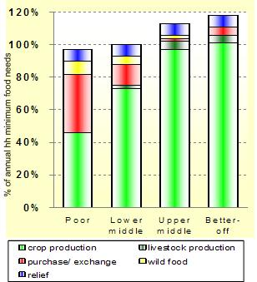
Some Common Themes
Sources of Food
The upper two groups are self-sufficient: their own production (crops and livestock) covers basic food needs
Gwembe Valley LZ, Zambia
Session 18: Understanding Agricultural Production Systems
Notes:
The graphs represent a livelihood zone in south-east Zambia, just off Lake Kariba, which as a whole is relatively self-sufficient in staple food production when not subject to drought or flooding. The year of reference is 2004, a year of more or less ordinary levels of production (and when food relief was distributed across the board but did not, in this case, reflect acute need). There is a notable skewing of self-sufficiency and surplus production for sale, towards the two upper wealth groups who together comprise some 40% of all households. The poor wealth group who comprise about a further 40% are usually unable to obtain more than half of their staple food requirement from their own fields, whilst the lower middle 20% have a gap of some one-fifth of their requirement. The poor make up most of their gap by working for others and obtaining payment directly in food ('exchange' of labour’); the lower middle group do this too but may rely more on food purchase. Seasonally collected wild foods are 'free' (although they require labour to gather and process) and even the upper middle households take advantage of this resource. But only they and the better off, who own by far the greater part of the area's cattle, are able to drink milk ('livestock production'), to any real extent, whilst at the other end the poor have no cattle and mainly not even any goats, so that if they very occasionally drink a little milk, it is milk donated to them by neighbours or kin.
Understanding Agricultural Production Systems

Slide 8
Some Common Themes
Sources of Food
The poor can not cover even half of their food needs with their own production
Gwembe Valley LZ, Zambia
Session 18: Understanding Agricultural Production Systems
Notes:
The graphs represent a livelihood zone in south-east Zambia, just off Lake Kariba, which as a whole is relatively self-sufficient in staple food production when not subject to drought or flooding. The year of reference is 2004, a year of more or less ordinary levels of production (and when food relief was distributed across the board but did not, in this case, reflect acute need). There is a notable skewing of self-sufficiency and surplus production for sale, towards the two upper wealth groups who together comprise some 40% of all households. The poor wealth group who comprise about a further 40% are usually unable to obtain more than half of their staple food requirement from their own fields, whilst the lower middle 20% have a gap of some one-fifth of their requirement. The poor make up most of their gap by working for others and obtaining payment directly in food ('exchange' of labour’); the lower middle group do this too but may rely more on food purchase. Seasonally collected wild foods are 'free' (although they require labour to gather and process) and even the upper middle households take advantage of this resource. But only they and the better off, who own by far the greater part of the area's cattle, are able to drink milk ('livestock production'), to any real extent, whilst at the other end the poor have no cattle and mainly not even any goats, so that if they very occasionally drink a little milk, it is milk donated to them by neighbours or kin.
Understanding Agricultural Production Systems

Slide 9
Some Common Themes
Sources of Food
They purchase over a third of their own food and collect wild foods to cover a portion of the remainder
Gwembe Valley LZ, Zambia
Session 18: Understanding Agricultural Production Systems
Notes:
The graphs represent a livelihood zone in south-east Zambia, just off Lake Kariba, which as a whole is relatively self-sufficient in staple food production when not subject to drought or flooding. The year of reference is 2004, a year of more or less ordinary levels of production (and when food relief was distributed across the board but did not, in this case, reflect acute need). There is a notable skewing of self-sufficiency and surplus production for sale, towards the two upper wealth groups who together comprise some 40% of all households. The poor wealth group who comprise about a further 40% are usually unable to obtain more than half of their staple food requirement from their own fields, whilst the lower middle 20% have a gap of some one-fifth of their requirement. The poor make up most of their gap by working for others and obtaining payment directly in food ('exchange' of labour’); the lower middle group do this too but may rely more on food purchase. Seasonally collected wild foods are 'free' (although they require labour to gather and process) and even the upper middle households take advantage of this resource. But only they and the better off, who own by far the greater part of the area's cattle, are able to drink milk ('livestock production'), to any real extent, whilst at the other end the poor have no cattle and mainly not even any goats, so that if they very occasionally drink a little milk, it is milk donated to them by neighbours or kin.
Understanding Agricultural Production Systems

Slide 10
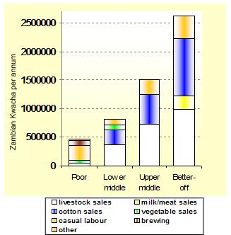
Some Common Themes
Sources of Cash
There is a more than 5-fold difference between the earnings of the poor and the better off
Gwembe Valley LZ, Zambia
Session 18: Understanding Agricultural Production Systems
Notes:
The pattern seen is one repeated very frequently in different African countries. In this - a not-wealthy rural area of a low income country, which is heavily dependent on a very limited repertoire of agricultural production - one thing that stands out is the more than five-fold difference between the earnings of typical poor and better off households (about $105 versus $540 per household of 6-8 people). The second thing of note is the great difference between the poor and the rest in sources of earnings. To be poor is essentially to work for others; in addition you try get value out of your labour by self-employment, in this case brewing and selling local beer, with ingredients usually purchased rather than produced by yourself; elsewhere common form of self-employment are cutting and selling firewood and grasses, or making handicraft items from grass, wool, wood or clay.
The threshold between poverty and relative wealth (as measured in local terms) is clearly defined by two factors. One is the ownership of livestock, and in this case the market demand from the not-too-distant capital city, Lusaka, adds value to animals and milk products. The second factor is the capacity to produce cash crops profitably. In this case the main cash crop is cotton, with its demand for labour (family or hired), fertilizers and pesticides. Elsewhere the staple maize or other crop may also be the cash crop in the sense that surpluses are regularly grown for sale by wealthier households. 'Other' earnings in this example include the hiring -out of oxen and ox-carts, remittances from family members working in the city or elsewhere, some small-scale trading, and sales of pigs and guinea fowl which are kept in numbers by some households.
Understanding Agricultural Production Systems

Slide 11
Some Common Themes
Sources of Cash
Sources of income differ substantially:
The poor work for others and are ‘self-employed’ (brewing, firewood sales, handicrafts, etc.)
Gwembe Valley LZ, Zambia
Session 18: Understanding Agricultural Production Systems
Notes:
The pattern seen is one repeated very frequently in different African countries. In this - a not-wealthy rural area of a low income country, which is heavily dependent on a very limited repertoire of agricultural production - one thing that stands out is the more than five-fold difference between the earnings of typical poor and better off households (about $105 versus $540 per household of 6-8 people). The second thing of note is the great difference between the poor and the rest in sources of earnings. To be poor is essentially to work for others; in addition you try get value out of your labour by self-employment, in this case brewing and selling local beer, with ingredients usually purchased rather than produced by yourself; elsewhere common form of self-employment are cutting and selling firewood and grasses, or making handicraft items from grass, wool, wood or clay.
The threshold between poverty and relative wealth (as measured in local terms) is clearly defined by two factors. One is the ownership of livestock, and in this case the market demand from the not-too-distant capital city, Lusaka, adds value to animals and milk products. The second factor is the capacity to produce cash crops profitably. In this case the main cash crop is cotton, with its demand for labour (family or hired), fertilizers and pesticides. Elsewhere the staple maize or other crop may also be the cash crop in the sense that surpluses are regularly grown for sale by wealthier households. 'Other' earnings in this example include the hiring -out of oxen and ox-carts, remittances from family members working in the city or elsewhere, some small-scale trading, and sales of pigs and guinea fowl which are kept in numbers by some households.
Understanding Agricultural Production Systems

Slide 12
Some Common Themes
Sources of Cash
Sources of income differ substantially:
The better off make money from sales of the things they produce: crops, milk/meat, livestock
Gwembe Valley LZ, Zambia
Session 18: Understanding Agricultural Production Systems
Notes:
The pattern seen is one repeated very frequently in different African countries. In this - a not-wealthy rural area of a low income country, which is heavily dependent on a very limited repertoire of agricultural production - one thing that stands out is the more than five-fold difference between the earnings of typical poor and better off households (about $105 versus $540 per household of 6-8 people). The second thing of note is the great difference between the poor and the rest in sources of earnings. To be poor is essentially to work for others; in addition you try get value out of your labour by self-employment, in this case brewing and selling local beer, with ingredients usually purchased rather than produced by yourself; elsewhere common form of self-employment are cutting and selling firewood and grasses, or making handicraft items from grass, wool, wood or clay.
The threshold between poverty and relative wealth (as measured in local terms) is clearly defined by two factors. One is the ownership of livestock, and in this case the market demand from the not-too-distant capital city, Lusaka, adds value to animals and milk products. The second factor is the capacity to produce cash crops profitably. In this case the main cash crop is cotton, with its demand for labour (family or hired), fertilizers and pesticides. Elsewhere the staple maize or other crop may also be the cash crop in the sense that surpluses are regularly grown for sale by wealthier households. 'Other' earnings in this example include the hiring -out of oxen and ox-carts, remittances from family members working in the city or elsewhere, some small-scale trading, and sales of pigs and guinea fowl which are kept in numbers by some households.
Understanding Agricultural Production Systems

Slide 13
Some Common Themes
Sources of Cash
The determinants of wealth here are:
Ownership of livestock
&
The capacity to produce cash crops profitably
Gwembe Valley LZ, Zambia
Session 18: Understanding Agricultural Production Systems
Notes:
The pattern seen is one repeated very frequently in different African countries. In this - a not-wealthy rural area of a low income country, which is heavily dependent on a very limited repertoire of agricultural production - one thing that stands out is the more than five-fold difference between the earnings of typical poor and better off households (about $105 versus $540 per household of 6-8 people). The second thing of note is the great difference between the poor and the rest in sources of earnings. To be poor is essentially to work for others; in addition you try get value out of your labour by self-employment, in this case brewing and selling local beer, with ingredients usually purchased rather than produced by yourself; elsewhere common form of self-employment are cutting and selling firewood and grasses, or making handicraft items from grass, wool, wood or clay.
The threshold between poverty and relative wealth (as measured in local terms) is clearly defined by two factors. One is the ownership of livestock, and in this case the market demand from the not-too-distant capital city, Lusaka, adds value to animals and milk products. The second factor is the capacity to produce cash crops profitably. In this case the main cash crop is cotton, with its demand for labour (family or hired), fertilizers and pesticides. Elsewhere the staple maize or other crop may also be the cash crop in the sense that surpluses are regularly grown for sale by wealthier households. 'Other' earnings in this example include the hiring -out of oxen and ox-carts, remittances from family members working in the city or elsewhere, some small-scale trading, and sales of pigs and guinea fowl which are kept in numbers by some households.
Understanding Agricultural Production Systems

Slide 14
Some Common Themes
Sources of Cash
Inter-dependence is a critical factor
The poor could not survive without being hired by the better off
Gwembe Valley LZ, Zambia
The better off would not profit from their production without the labour of the poor
Session 18: Understanding Agricultural Production Systems
Notes:
The pattern seen is one repeated very frequently in different African countries. In this - a not-wealthy rural area of a low income country, which is heavily dependent on a very limited repertoire of agricultural production - one thing that stands out is the more than five-fold difference between the earnings of typical poor and better off households (about $105 versus $540 per household of 6-8 people). The second thing of note is the great difference between the poor and the rest in sources of earnings. To be poor is essentially to work for others; in addition you try get value out of your labour by self-employment, in this case brewing and selling local beer, with ingredients usually purchased rather than produced by yourself; elsewhere common form of self-employment are cutting and selling firewood and grasses, or making handicraft items from grass, wool, wood or clay.
We see something about the inter-dependence of the different wealth-groups: the poorer households could not survive here without being hired by the wealthier households. The wealthier households could not maximise their profits from farming, especially of cotton, without the labour of the poor; and they even make back some of their money from poorer households by hiring draft animals to them. On the other hand, the wealthier households are the main customers for the vegetables produced and the beer brewed by the poorer farmers.
The threshold between poverty and relative wealth (as measured in local terms) is clearly defined by two factors. One is the ownership of livestock, and in this case the market demand from the not-too-distant capital city, Lusaka, adds value to animals and milk products. The second factor is the capacity to produce cash crops profitably. In this case the main cash crop is cotton, with its demand for labour (family or hired), fertilizers and pesticides. Elsewhere the staple maize or other crop may also be the cash crop in the sense that surpluses are regularly grown for sale by wealthier households. 'Other' earnings in this example include the hiring -out of oxen and ox-carts, remittances from family members working in the city or elsewhere, some small-scale trading, and sales of pigs and guinea fowl which are kept in numbers by some households.
Understanding Agricultural Production Systems

Slide 15
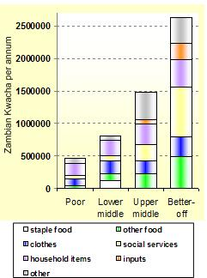
Some Common Themes
Expenditure
Only lower middle hhs purchase staple foods
The poor work for food in kind and the wealthier hhs produce enough of their own staples not to need to purchase
Gwembe Valley LZ, Zambia
Session 18: Understanding Agricultural Production Systems
Notes:
staple food purchase is a feature only of the lower middle households because on the one hand the poor obtain food by working directly for it as payment (as shown above), whilst the wealthier households cover their own staple requirements from their production. By contrast, 'other food' purchases - the daily relish items and the oil and sugar that add quality and palatability to the diet - are almost a luxury for the poor, without even considering milk products, or meat, or fish brought in from the nearby Lake Kariba. The poor have other pressing demands for the little cash they can spend: the most basic 'household items' - salt, soap, candles or diesel for a single lamp, milling costs - mount up day by day to represent their major expenditure.
On the other hand, the wealthier you are, the more you spend on agricultural inputs, notably for cash cropping as seen above, and on clothes, and on 'other' items, which typically includes the costs of ceremonies as well as modest luxuries ranging from a radio and batteries to the beer produced by poorer households, or bus fares for town visits and perhaps a bottle or two of the commercial beer. But the most glaring difference between the better off and the others is the expenditure on social services. This includes mainly expenditure on education, and less regularly on medicine. The education element is of particular significance in offering a longer-term message. Poor people no less than better off households are clear, and often voluble in discussion, about the crucial value of education for their children. In a sense it is seen as the one real path away from the problems encapsulated above as 'land shortage': education out of direct dependence on land and into the wider sphere of professional employment. What the above graph tells us is that the poorer 60% of households can hardly afford to put their children through primary schooling, which anyway does not usually lead to employment. On the other hand, wealthier people can at least face the costs of secondary schooling, which very often requires paying for a child to live away from home in a town, if not of education beyond that.
Finally, we see something about the inter-dependence of the different wealth-groups: the poorer households could not survive here without being hired by the wealthier households. The wealthier households could not maximise their profits from farming, especially of cotton, without the labour of the poor; and they even make back some of their money from poorer households by hiring draft animals to them. On the other hand, the wealthier households are the main customers for the vegetables produced and the beer brewed by the poorer farmers.
Understanding Agricultural Production Systems

Slide 16
Some Common Themes
Expenditure
The poor spend much of their cash on household items: salt, soap, kerosene, milling, etc.
Gwembe Valley LZ, Zambia
Session 18: Understanding Agricultural Production Systems
Notes:
staple food purchase is a feature only of the lower middle households because on the one hand the poor obtain food by working directly for it as payment (as shown above), whilst the wealthier households cover their own staple requirements from their production. By contrast, 'other food' purchases - the daily relish items and the oil and sugar that add quality and palatability to the diet - are almost a luxury for the poor, without even considering milk products, or meat, or fish brought in from the nearby Lake Kariba. The poor have other pressing demands for the little cash they can spend: the most basic 'household items' - salt, soap, candles or diesel for a single lamp, milling costs - mount up day by day to represent their major expenditure.
On the other hand, the wealthier you are, the more you spend on agricultural inputs, notably for cash cropping as seen above, and on clothes, and on 'other' items, which typically includes the costs of ceremonies as well as modest luxuries ranging from a radio and batteries to the beer produced by poorer households, or bus fares for town visits and perhaps a bottle or two of the commercial beer. But the most glaring difference between the better off and the others is the expenditure on social services. This includes mainly expenditure on education, and less regularly on medicine. The education element is of particular significance in offering a longer-term message. Poor people no less than better off households are clear, and often voluble in discussion, about the crucial value of education for their children. In a sense it is seen as the one real path away from the problems encapsulated above as 'land shortage': education out of direct dependence on land and into the wider sphere of professional employment. What the above graph tells us is that the poorer 60% of households can hardly afford to put their children through primary schooling, which anyway does not usually lead to employment. On the other hand, wealthier people can at least face the costs of secondary schooling, which very often requires paying for a child to live away from home in a town, if not of education beyond that.
Finally, we see something about the inter-dependence of the different wealth-groups: the poorer households could not survive here without being hired by the wealthier households. The wealthier households could not maximise their profits from farming, especially of cotton, without the labour of the poor; and they even make back some of their money from poorer households by hiring draft animals to them. On the other hand, the wealthier households are the main customers for the vegetables produced and the beer brewed by the poorer farmers.
Understanding Agricultural Production Systems

Slide 17
Some Common Themes
Expenditure
The wealthier you are the more you spend on agricultural inputs
Gwembe Valley LZ, Zambia
Session 18: Understanding Agricultural Production Systems
Notes:
The wealthier you are, the more you spend on agricultural inputs, notably for cash cropping as seen above, and on clothes, and on 'other' items, which typically includes the costs of ceremonies as well as modest luxuries ranging from a radio and batteries to the beer produced by poorer households, or bus fares for town visits and perhaps a bottle or two of the commercial beer. But the most glaring difference between the better off and the others is the expenditure on social services. This includes mainly expenditure on education, and less regularly on medicine. The education element is of particular significance in offering a longer-term message. Poor people no less than better off households are clear, and often voluble in discussion, about the crucial value of education for their children. In a sense it is seen as the one real path away from the problems encapsulated above as 'land shortage': education out of direct dependence on land and into the wider sphere of professional employment. What the above graph tells us is that the poorer 60% of households can hardly afford to put their children through primary schooling, which anyway does not usually lead to employment. On the other hand, wealthier people can at least face the costs of secondary schooling, which very often requires paying for a child to live away from home in a town, if not of education beyond that.
Finally, we see something about the inter-dependence of the different wealth-groups: the poorer households could not survive here without being hired by the wealthier households. The wealthier households could not maximise their profits from farming, especially of cotton, without the labour of the poor; and they even make back some of their money from poorer households by hiring draft animals to them. On the other hand, the wealthier households are the main customers for the vegetables produced and the beer brewed by the poorer farmers.
Understanding Agricultural Production Systems

Slide 18
Some Common Themes
Expenditure
The better off spend significantly more on social services, and especially education. Poor households can barely afford to cover primary school.
Gwembe Valley LZ, Zambia
Session 18: Understanding Agricultural Production Systems
Notes:
The wealthier you are, the more you spend on agricultural inputs, notably for cash cropping as seen above, and on clothes, and on 'other' items, which typically includes the costs of ceremonies as well as modest luxuries ranging from a radio and batteries to the beer produced by poorer households, or bus fares for town visits and perhaps a bottle or two of the commercial beer. But the most glaring difference between the better off and the others is the expenditure on social services. This includes mainly expenditure on education, and less regularly on medicine. The education element is of particular significance in offering a longer-term message. Poor people no less than better off households are clear, and often voluble in discussion, about the crucial value of education for their children. In a sense it is seen as the one real path away from the problems encapsulated above as 'land shortage': education out of direct dependence on land and into the wider sphere of professional employment. What the above graph tells us is that the poorer 60% of households can hardly afford to put their children through primary schooling, which anyway does not usually lead to employment. On the other hand, wealthier people can at least face the costs of secondary schooling, which very often requires paying for a child to live away from home in a town, if not of education beyond that.
Understanding Agricultural Production Systems

Slide 19
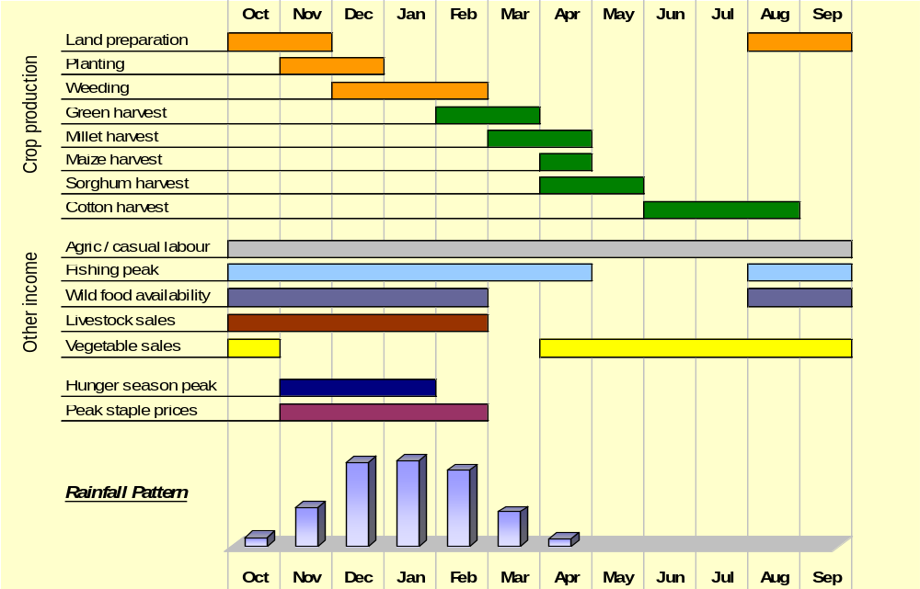
Some Common Themes
Seasonality
A single rainy season must be taken full advantage of
Gwembe Valley LZ, Zambia
Session 18: Understanding Agricultural Production Systems
Notes:
This example shows the dynamic view obtained in this way of household economy revolving around a single rainy season giving five months of agricultural moisture. We see the staggered harvests of staples - millet, maize and sorghum; we note that the cotton harvest comes later, so that labour does not have to be divided between grain and cash-crop harvesting, although it must be shared during part of the respective growing periods. We see that the all-important local casual employment for the poor lasts all year to a greater or lesser extent from land preparation beginning in August through planting and weeding to harvesting which for cotton reaches into the next August. We see that the small contribution of different wild foods spreads usefully across part of the dry season as well as the wet season, as does the minority fishing activity, whilst vegetable production is a dry-season occupation, depending on small irrigation. We see that livestock sales peak during the rains, when the animals are in better condition from the regenerated grazing, and the price food purchase is at its highest before the harvest. Finally we see that for many a poor household, despite all the activities in which they engage on and off their land, there comes a season of hunger before the harvest, when previous harvest stocks are long gone, and food prices are high, and even labour payment in grain must wait until the new harvest - a period only broken by the consumption of green maize, at some cost to the mature harvest.
Understanding Agricultural Production Systems

Slide 20
Some Common Themes
Seasonality
A staggered harvest of staples helps keep labour needs spread out
Gwembe Valley LZ, Zambia
Session 18: Understanding Agricultural Production Systems
Notes:
This example shows the dynamic view obtained in this way of household economy revolving around a single rainy season giving five months of agricultural moisture. We see the staggered harvests of staples - millet, maize and sorghum; we note that the cotton harvest comes later, so that labour does not have to be divided between grain and cash-crop harvesting, although it must be shared during part of the respective growing periods. We see that the all-important local casual employment for the poor lasts all year to a greater or lesser extent from land preparation beginning in August through planting and weeding to harvesting which for cotton reaches into the next August. We see that the small contribution of different wild foods spreads usefully across part of the dry season as well as the wet season, as does the minority fishing activity, whilst vegetable production is a dry-season occupation, depending on small irrigation. We see that livestock sales peak during the rains, when the animals are in better condition from the regenerated grazing, and the price food purchase is at its highest before the harvest. Finally we see that for many a poor household, despite all the activities in which they engage on and off their land, there comes a season of hunger before the harvest, when previous harvest stocks are long gone, and food prices are high, and even labour payment in grain must wait until the new harvest - a period only broken by the consumption of green maize, at some cost to the mature harvest.
Understanding Agricultural Production Systems

Slide 21
Some Common Themes
Seasonality
Labour (for the poor hhs) is critical throughout the year
Gwembe Valley LZ, Zambia
Session 18: Understanding Agricultural Production Systems
Notes:
This example shows the dynamic view obtained in this way of household economy revolving around a single rainy season giving five months of agricultural moisture. We see the staggered harvests of staples - millet, maize and sorghum; we note that the cotton harvest comes later, so that labour does not have to be divided between grain and cash-crop harvesting, although it must be shared during part of the respective growing periods. We see that the all-important local casual employment for the poor lasts all year to a greater or lesser extent from land preparation beginning in August through planting and weeding to harvesting which for cotton reaches into the next August. We see that the small contribution of different wild foods spreads usefully across part of the dry season as well as the wet season, as does the minority fishing activity, whilst vegetable production is a dry-season occupation, depending on small irrigation. We see that livestock sales peak during the rains, when the animals are in better condition from the regenerated grazing, and the price food purchase is at its highest before the harvest. Finally we see that for many a poor household, despite all the activities in which they engage on and off their land, there comes a season of hunger before the harvest, when previous harvest stocks are long gone, and food prices are high, and even labour payment in grain must wait until the new harvest - a period only broken by the consumption of green maize, at some cost to the mature harvest.
Understanding Agricultural Production Systems

Slide 22
Some Common Themes
Seasonality
Fishing and wild foods fill seasonal gaps
Gwembe Valley LZ, Zambia
Session 18: Understanding Agricultural Production Systems
Notes:
This example shows the dynamic view obtained in this way of household economy revolving around a single rainy season giving five months of agricultural moisture. We see the staggered harvests of staples - millet, maize and sorghum; we note that the cotton harvest comes later, so that labour does not have to be divided between grain and cash-crop harvesting, although it must be shared during part of the respective growing periods. We see that the all-important local casual employment for the poor lasts all year to a greater or lesser extent from land preparation beginning in August through planting and weeding to harvesting which for cotton reaches into the next August. We see that the small contribution of different wild foods spreads usefully across part of the dry season as well as the wet season, as does the minority fishing activity, whilst vegetable production is a dry-season occupation, depending on small irrigation. We see that livestock sales peak during the rains, when the animals are in better condition from the regenerated grazing, and the price food purchase is at its highest before the harvest. Finally we see that for many a poor household, despite all the activities in which they engage on and off their land, there comes a season of hunger before the harvest, when previous harvest stocks are long gone, and food prices are high, and even labour payment in grain must wait until the new harvest - a period only broken by the consumption of green maize, at some cost to the mature harvest.
Understanding Agricultural Production Systems

Slide 23
Some Common Themes
Seasonality
Livestock sales peak in the rainy season, when livestock condition is best
Gwembe Valley LZ, Zambia
Session 18: Understanding Agricultural Production Systems
Notes:
This example shows the dynamic view obtained in this way of household economy revolving around a single rainy season giving five months of agricultural moisture. We see the staggered harvests of staples - millet, maize and sorghum; we note that the cotton harvest comes later, so that labour does not have to be divided between grain and cash-crop harvesting, although it must be shared during part of the respective growing periods. We see that the all-important local casual employment for the poor lasts all year to a greater or lesser extent from land preparation beginning in August through planting and weeding to harvesting which for cotton reaches into the next August. We see that the small contribution of different wild foods spreads usefully across part of the dry season as well as the wet season, as does the minority fishing activity, whilst vegetable production is a dry-season occupation, depending on small irrigation. We see that livestock sales peak during the rains, when the animals are in better condition from the regenerated grazing, and the price food purchase is at its highest before the harvest. Finally we see that for many a poor household, despite all the activities in which they engage on and off their land, there comes a season of hunger before the harvest, when previous harvest stocks are long gone, and food prices are high, and even labour payment in grain must wait until the new harvest - a period only broken by the consumption of green maize, at some cost to the mature harvest.
Understanding Agricultural Production Systems

Slide 24
Some Common Themes
Seasonality
Vegetable sales is a dry season occupation
Gwembe Valley LZ, Zambia
Session 18: Understanding Agricultural Production Systems
Notes:
This example shows the dynamic view obtained in this way of household economy revolving around a single rainy season giving five months of agricultural moisture. We see the staggered harvests of staples - millet, maize and sorghum; we note that the cotton harvest comes later, so that labour does not have to be divided between grain and cash-crop harvesting, although it must be shared during part of the respective growing periods. We see that the all-important local casual employment for the poor lasts all year to a greater or lesser extent from land preparation beginning in August through planting and weeding to harvesting which for cotton reaches into the next August. We see that the small contribution of different wild foods spreads usefully across part of the dry season as well as the wet season, as does the minority fishing activity, whilst vegetable production is a dry-season occupation, depending on small irrigation. We see that livestock sales peak during the rains, when the animals are in better condition from the regenerated grazing, and the price food purchase is at its highest before the harvest. Finally we see that for many a poor household, despite all the activities in which they engage on and off their land, there comes a season of hunger before the harvest, when previous harvest stocks are long gone, and food prices are high, and even labour payment in grain must wait until the new harvest - a period only broken by the consumption of green maize, at some cost to the mature harvest.
Understanding Agricultural Production Systems

Slide 25
Some Common Themes
Seasonality
The hunger season occurs right before the harvest, when food prices also peak
Gwembe Valley LZ, Zambia
Session 18: Understanding Agricultural Production Systems
Notes:
This example shows the dynamic view obtained in this way of household economy revolving around a single rainy season giving five months of agricultural moisture. We see the staggered harvests of staples - millet, maize and sorghum; we note that the cotton harvest comes later, so that labour does not have to be divided between grain and cash-crop harvesting, although it must be shared during part of the respective growing periods. We see that the all-important local casual employment for the poor lasts all year to a greater or lesser extent from land preparation beginning in August through planting and weeding to harvesting which for cotton reaches into the next August. We see that the small contribution of different wild foods spreads usefully across part of the dry season as well as the wet season, as does the minority fishing activity, whilst vegetable production is a dry-season occupation, depending on small irrigation. We see that livestock sales peak during the rains, when the animals are in better condition from the regenerated grazing, and the price food purchase is at its highest before the harvest. Finally we see that for many a poor household, despite all the activities in which they engage on and off their land, there comes a season of hunger before the harvest, when previous harvest stocks are long gone, and food prices are high, and even labour payment in grain must wait until the new harvest - a period only broken by the consumption of green maize, at some cost to the mature harvest.
Understanding Agricultural Production Systems

Slide 26


Summary:
Basic determinants of wealth
The wealthier you are, the more land you own or control (through renting in)
Land
The wealthier you are, the more livestock you own and use for income/savings
Livestock
The poorer you are, the more you rely on selling your labour
Labour
Other assets
The wealthier you are, the more other assets you own and convert into profit
Session 18: Understanding Agricultural Production Systems
Notes:
Understanding Agricultural Production Systems

Slide 27

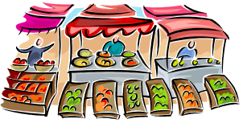
Summary:
Basic dynamics of livelihood
Food
The poorer you are, the less you produce on your own, and the more you purchase or work for in kind
Cash
The wealthier you are, the more profit you can generate on your own production (crops, livestock, milk/meat, etc.)
Expenditure
The poorer you are, the more of your total income is spent on food and basic hh goods; little is left for school and health
Session 18: Understanding Agricultural Production Systems
Notes:
Understanding Agricultural Production Systems

